Slide 1
Data Science Infrastructure
Medial EarlySign

Slide 2
Agenda
The challenges
The need for a platform
Birdseye overview
Diving into the details:
Data
Data Repository
Training infrastructure
Analysis
Productization
Hands on example

Slide 3
Introduction – The Challenges

Slide 4
The Challenges – a Plethora of Different Questions
What is the probability of our patient to develop a certain condition?
Colorectal Cancer, Lung Cancer, AAA, Diabetes, CKD, ...
What is the probability that our patient complies?
gets vaccinated, takes medications, visits a GP, …
Should we ask our patient to take a blood test?
Glucose, HbA1C, Creatinine, …
Should we discharge our patient ?
From ER, Hospital ward, ICU
What would most GPs (or specialists) prescribe for our patient?
Which patients would benefit most from an action?
vaccination, home visit, life-style intervention, …
What will be the effect of treating my patient with a specific drug?
Is Drug A better than Drug B for my patient?

Slide 5

The Challenge of AI Using Medical Data
Data is temporal, yet highly irregular
Need to create features that capture dynamics
Some highly categorical signals
Diagnoses, Procedures, Medications
100k and more dimensions
Data comprises of different types of signals
Many signals are sparse
Data is often not standardized

Slide 6
The Challenge of AI Using Retrospective Data
Data not collected in controlled environment –
It is partial and extremely noisy
Biased
Rich in spurious patterns that make generalization difficult
Sensitive to changes in health care policies
Some examples of challenges to come …

Slide 7
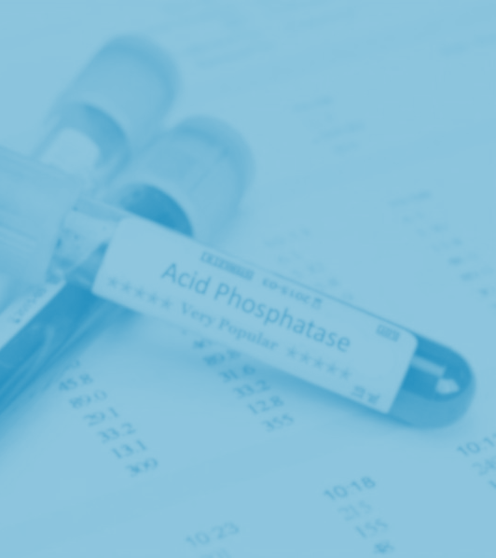
Imaging
Medical records

Slide 8
Introduction – The Need for a Platform

Slide 9
The Need for a Platform
Many different questions use common methodologies
Accumulated knowledge should be maintained, shared and reused
Can’t write everything from scratch every time
Bugs, bugs and more bugs
Waste of precious time
No ready ML platform specializing in medical data.
Medical data is different
Enable easy transfer from research to product
Comply with regulation
Enable versioning

Slide 10
The Requirements from a Platform
Ultra efficient in memory and time
Allow generating rich and varied set of features
Expandable when new ideas pop
Support state of the art ML models
Configurable : minimal need for rewriting code
Minimal productization effort
All encompassing – from data import to analysis and productization
Unified – handle multiple scenarios
Rich APIs to allow easy extension
Reproducible, versioned, debugged
Transfer medical ML to a group effort – create a “language”

Slide 11
The Need for a Platform
Many different questions use common methodologies
Can’t write everything from scratch every time
Bugs, bugs and more bugs
Waste of precious time
No ready ML platform specializing in medical data.
Medical data is different
Enable easy transfer from research to product
Comply with Regulation
Enable Versioning

Slide 12
Why not use an off the shelf tool?
R, MATLAB, SciKit-Learn, TensorFlow (and extensions), etc. – all offer partial solutions.
Need | Existing Platforms
Unified medical data model | X
Configurable | ~ – Can adjust some parameters for models, but can’t configure the WHOLE process and need to do it in code
Rich and varied features set | X – Need to rewrite for each project
Analysis Tools | X – Very basic, Not matching medical analysis
Efficient in memory and speed | ~ - Training runs OK, the rest is highly not efficient.
All encompassing | X – Often start from matrix
Productization | X – Hard, need to write all the missing stuff
Easy extension | X – Often hard to make changes. Users tend to stick to the available tools
Group effort | X – Each project development is independent of others

Slide 13
Birdseye Overview

Slide 14
Elements of the Infrastructure
Data Repository
Unified
High Performance
Training Infrastructure
Deal with Time Dimension
Configurable
Matrix Generation
Training and Analysis
Productization
Single File AlgoMarkers
Easy Productization
Use within AlgoAnalyzer
On prem Sandboxes
Software Wrappers (Apps, Python)
Easy Setup (Docker)
Efficiency

Slide 15
Summary of Methodology
Model construction: Modular, C++ libraries, python APIs
Data Preparation
Model Generation
Data Model: Unified, efficient in time and memory
Validation & Analysis
Exporting
Datasets
Importing, Organization, Normalization, Ontologies
Cohort Preparation
Selecting population, Sampling, Labeling
Repository Processors
Outliers, Enrichment
Feature Generators
Moments, Trends, Embedding, Encoders
Feature Processors
Imputation, Feature Selection
Predictors
Regression, Trees, Boosting, Neural-Nets
Post-Process
Recalibration, Interpretation
Validation
Performance analysis, Bootstrapping, multiple datasets
AlgoAnalyzer
Export as AlgoMarker
Notes:
Option 1

Slide 16
Diving into the Details

Slide 17
Summary of Methodology
Model construction: Modular, C++ libraries, python APIs
Data Preparation
Model Generation
Data Model: Unified, efficient in time and memory
Validation & Analysis
Exporting
Datasets
Importing, Organization, Normalization, Ontologies
Cohort Preparation
Selecting population, Sampling, Labeling
Repository Processors
Outliers, Enrichment
Feature Generators
Moments, Trends, Embedding, Encoders
Feature Processors
Imputation, Feature Selection
Predictors
Regression, Trees, Boosting, Neural-Nets
Post-Process
Recalibration, Interpretation
Validation
Performance analysis, Bootstrapping, multiple datasets
AlgoAnalyzer
Export as AlgoMarker
Notes:
Option 1

Slide 18

Structured Medical Record
Demographics
Lab Tests
Diagnosis
Drugs
Procedures
Admissions

Slide 19
What Else Should We Expect ?
Textual Summaries
Continuous Signals (ECG,…)
Imaging Data
Proteomics
Genomics - SNPs data
Genomics - Sequencing

Slide 20
Data Sources
Outpatients:
MHS – Israel, 3M (>2M members currently), almost 20 years of data
THIN – UK, 16M, 18 years of data
KPNW – US, 2M (>600k members), 10 years of data
Canadian data set – 300k , 10 years
KPSC – US, Lung Cancer dataset (patients and controls)
GHS – US, design partner. Large dataset.
Inpatients:
Rambam – large Israeli hospital, >200k patients, 15 years
Mimic – public ICU dataset
eICU – large public ICU dataset

Slide 21
Data Loading Process
Quality-managed and controlled procedure:
Check consistency with pre-defined data content
Load data to staging DB
Create mapping from data elements to common terminology
Check data quality and validity using value histograms
Check consistency by time, age, gender and other covariates
Import or build required ontologies and dictionaries
Load to repository

Slide 22
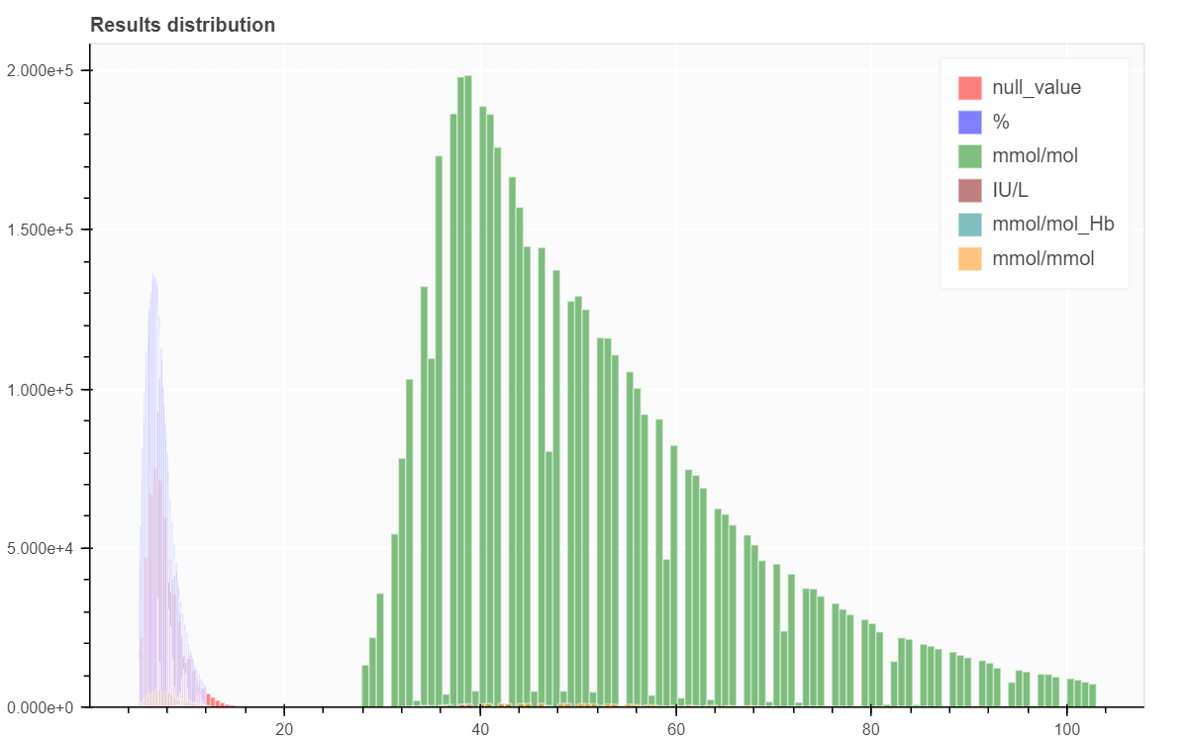
Input Data – Challenge with Units
HbA1C : distribution of results per different units as marked in input data.
Distribution does not always match marked units
Solution: Apply explicit and distribution-based unit conversion

Slide 23
Input Data – Ontologies
Solution : Use/Extend available dictionaries between ontologies
Field | Ontologies
Medical Terms | ICD-9/10, SnoMed, Read Codes (UK), DRG, Internal dictionaries
Medications | Names, ATC, RxNorm, BNF, NDC

Slide 24
Input Data – Resolutions
Central Districts
Northern Districts
Central Lab
High Socio-economic & education level
Lower Socio-economic & education level
Northern Lab
Hematology analyzer A
More Screening colonoscopies
More Symptomatic colonoscopies
Hematology Analyzer B
Bas# Resolution 0.1
Lower Findings Rate
Higher Findings Rate
Bas# Resolution 0.01
Spurious dependency between Bas# resolution level and Colonoscopy finding rate
Solution : Normalize resolution to avoid spurious patterns

Slide 25
Data Input – Inpatient vs Outpatient
Information often not directly given for various tests
Values distribution may be very different
Use admission information, when given, to mark inpatient tests
Use test frequency for further identification of admission periods

Slide 26
Summary of Methodology
Model construction: Modular, C++ libraries, python APIs
Data Preparation
Model Generation
Data Model: Unified, efficient in time and memory
Validation & Analysis
Exporting
Datasets
Importing, Organization, Normalization, Ontologies
Cohort Preparation
Selecting population, Sampling, Labeling
Repository Processors
Outliers, Enrichment
Feature Generators
Moments, Trends, Embedding, Encoders
Feature Processors
Imputation, Feature Selection
Predictors
Regression, Trees, Boosting, Neural-Nets
Post-Process
Recalibration, Interpretation
Validation
Performance analysis, Bootstrapping, multiple datasets
AlgoAnalyzer
Export as AlgoMarker
Notes:
Option 1

Slide 27
Data Model – Major Needs
Unified
Data repository
Memory Efficient
Common API for:
Demographics/Lab/Medication, etc.
Inpatient/Outpatient
Different data sources normalized at loading
Feasible with a single computer
Minimize disk access
Fast
Cluster extendable for richer data sources (Omics, Continuous Signals)
Basic Operation: get all events of a given signal per patient sorted by time
Increased number of cycles = better chance to improve performance

Slide 28
Signal – Data Model’s Basic Element
A signal represents a specific type of data across the dataset
A signal is characterized by:
Number of time (date) channels (0 or more)
Number of value channels (0 or more)
Each value entry can be numerical or categorical
An individual is assigned a (possibly empty) vector of entries per signal

Slide 29
Signal – Data Model’s Basic Element
Examples of signals –
Gender :
0 time-channels
1 value-channel, categorial (Male/Female)
Hemoglobin :
1 time-channel (date/time of test)
1 value-channel (numerical)
Medication :
1 time-channel (date of prescription)
2 value-channels: drug name (categorical), length of prescription (numerical)
Extendable – additional value-channels for dosage, packaging

Slide 30
Signal – Future data types
Textual Summaries - BLOBs
Continuous Signals – Multiple binary value channels
Proteomics – Multiple signals or value channels
Genomics – BLOBs
Some redesign will be needed for full genome/exome sequencing

Slide 31
Assuring Time and Memory Efficiency
For each patient and signal, keep records sorted by time
Keep data for the same patient/signal continuous in memory.
Use efficient indexing to the position of the sorted vector per each patient and signal
Applied both to disk and memory
Indexing required minimal additional data (a few bits per patient)
Do not copy data unless absolutely necessary
Simply return the pointer to the start of the record.
Use minimal number of bytes for each value (int, short, float, char, etc.)
Never save strings for categorial signals, use dictionaries
Data kept in the best manner for CPU cache usage

Slide 32
Data Model – Categorical Signals
Efficiently maintain information using dictionaries and hierarchies.
Build a dictionary mapping each category to a numerical value
Keep only numerical values per patient
Use unified, efficient APIs to translate numerical values to category descriptions
Hierarchies are defined by adding new entries to dictionary (sets)
A set can contain other elements in the dictionary (atomic elements, or other sets)
Efficient APIs allow querying using sets:
Is a given element contained in a set ?
Find all entries per patient, in which there was a value contained in a set

Slide 33
Data Model – Categorical Signals
Example:
Drugs - Can be a 100K or more different options (active ingredient, names, dosages, packaging, etc.)
Different levels of hierarchies are possible
Drug name – ignoring dosage, packaging, etc.
Active ingredient (e.g. ATC code)
Higher level in ATC hierarchy (e.g. A10 represents Diabetes drugs)

Slide 34
Data Repository - Implementation
InfraMed/MedRepository:
Large C++ library to handle:
Loading of new repositories
Adding data to an existing repository
Reading all or a subset of the data into memory (only the needed patients and required signals)
Basic operation: get(patient, signal) - extremely fast
Unified APIs to get time and value channels
APIs for dictionaries usage : querying, translating, hierarchies.
Python APIs wrapping the C++ code.

Slide 35
MedRepository Advantages
Extremely fast – enabler
100x faster in reading and querying data for ML training and testing.
Optimized for common queries (getting a signal per patient, accessing categorical dictionaries)
Works well on strong machines, don’t even need a large cluster:
A strong server with >64GB RAM and >8 cores is already giving good results.
Normalization (names, units, ontologies) done at loading stage
Test transferability of models to different data sets
Use different data sets in training
A general, thin, lowermost layer
Ability to develop complex tools that can be used in a general way on a huge set of problems.
Common to both development and applying stages
Automatic tools for QA & testing of quality.
Ultra efficient C++ API on top to enable complex operations – train, test, query, viewers, etc.)

Slide 36
Summary of Methodology
Model construction: Modular, C++ libraries, python APIs
Data Preparation
Model Generation
Data Model: Unified, efficient in time and memory
Validation & Analysis
Exporting
Datasets
Importing, Organization, Normalization, Ontologies
Cohort Preparation
Selecting population, Sampling, Labeling
Repository Processors
Outliers, Enrichment
Feature Generators
Moments, Trends, Embedding, Encoders
Feature Processors
Imputation, Feature Selection
Predictors
Regression, Trees, Boosting, Neural-Nets
Post-Process
Recalibration, Interpretation
Validation
Performance analysis, Bootstrapping, multiple datasets
AlgoAnalyzer
Export as AlgoMarker
Notes:
Option 1

Slide 37
Cohort Preparation
A cohort represents the set of relevant individuals with –
Time of entry to the cohort
Time of leaving the cohort
Timeline of relevant disease/condition - Registry
Influenza
Diabetes
Lung Cancer
Healthy/Sick
2013
2014
2015
2016
2017
2018
Healthy
2013
2014
2015
2016
2017
2018
Pre DM
2013
2014
2015
2016
2017
2018
Pre DM to DM
2013
2014
2015
2016
2017
2018
Control
2013
2014
2015
2016
2017
2018
Case
2013
2014
2015
2016
2017
2018

Slide 38
Cohort Preparation - Registries
Correct Registries are essential for developing a valid model
Data used for Registry building:
Diagnosis codes
Almost never enough:
Under-diagnosis and under-recording is very common
Diagnosis is often too late

Slide 39
Cohort Preparation - Registries
Correct Registries are essential for developing a valid model
Data used for Registry building:
Diagnosis codes
Medication
Procedure codes
Lab Tests

Slide 40
Cohort Preparation - Registries
Examples of registries –
Cancer – National/Internal registries
Diabetes – DX codes, glucose & HbA1C tests, Medications
Hyper-Tension – DX codes, BP reads, Medications
The challenge – many medications are also used for other conditions
CKD – DX codes, Creatinine/eGFR, Urine protein tests
Influenza – DX codes & Vaccination Info

Slide 41
Challenges in Cohort Preparation
Never peek at the future !
DM is often defined according to two consecutive abnormal (>120 mg/dL) glucose tests
Naïve approach – find such two consecutive reads and mark the first one as the beginning of the disease.
But this gives us a glimpse into the future …
2013
2014
2015
2016
2017
2018
Abnormal Glucose test
DM Healthy Status
Glucose tests MUST be normal within this range !!!

Slide 42
Sampling
Samples represent the set of relevant individual with time-points for learning/predictions
An individual can have more than one time-point
Each sample (individual + time-point) is assigned a label
Samples are derived from the cohort
Multiple sampling methods are possible
Sample at regular time points
Sample when certain tests are taken
Sample differently for cases and controls (beware of biases !)

Slide 43
Challenges in Sampling
2013
2014
2015
2016
2017
2018
Improved recording of target condition
Cases
Controls
Changes in policies or calibration of machines
Classifiers identify time and use it as a feature
Solution : Match samples by year (or other parameters)
Matching can also be used in learning and analysis

Slide 44
Sampling - Examples
Colorectal Cancer (LGI Flag)
Sample at times of CBCs.
Random sampling for controls
For cases, take two last samples within 24 to 1 months before DX
Increasing the gap between sample and DX can prevent using tests that are part of the diagnosis process
Influenza
Sample at 01/09 for each valid year for each individual
Pre-DM to DM
Sample at a random time point within each valid half-year period for each individual

Slide 45
Summary of Methodology
Model construction: Modular, C++ libraries, python APIs
Data Preparation
Model Generation
Data Model: Unified, efficient in time and memory
Validation & Analysis
Exporting
Datasets
Importing, Organization, Normalization, Ontologies
Cohort Preparation
Selecting population, Sampling, Labeling
Repository Processors
Outliers, Enrichment
Feature Generators
Moments, Trends, Embedding, Encoders
Feature Processors
Imputation, Feature Selection
Predictors
Regression, Trees, Boosting, Neural-Nets
Post-Process
Recalibration, Interpretation
Validation
Performance analysis, Bootstrapping, multiple datasets
AlgoAnalyzer
Export as AlgoMarker
Notes:
Option 1

Slide 46
Repository Processors
Apply processes on signals before generating features:
Cleaners : find and clean outlying values
Panel completers : complete signals that can be calculated using other signals (e.g. MCH = Hematocrit/RBC)
Check requirements : Is a sample eligible to participate in model training/testing
Handle simultaneous reads (e.g. multiple glucose reads at the same date)
Generate virtual signals – create new signals that capture composite information and can be used to generate features

Slide 47
Repository Processors
Cleaners : Handle outliers
Outliers may represent technical errors or real, yet extremely rare values
Technical errors should be removed, real values may be trimmed
Possible cleaning methods:
Pre-configured/Rule based – Use prior knowledge on allowed/accepted values
Learning – Evaluate ‘clean’ distribution from learning set and then use it to identify outliers
Neighborhood Based – Use neighboring (in time) reads to improve identification of outliers

Slide 48
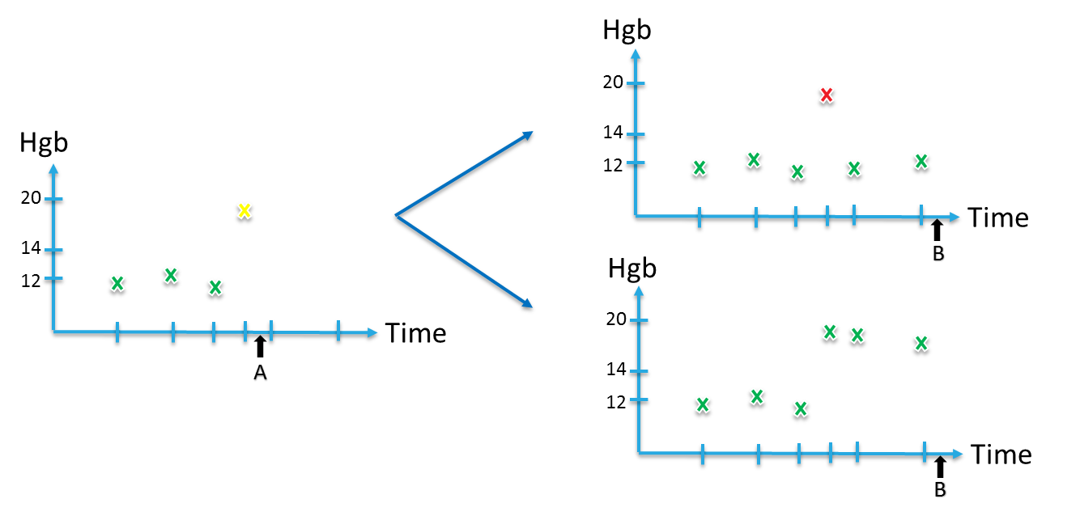
Repository Processors - Versioning
Cleaning may depend on time of application
Never use information from the future
Outliers decision is different in time points A and B
We need to create different versions of the information for different samples
Our infrastructure does the ‘right thing’ but also as efficiently as possible (not maintaining multiple versions when not necessary)

Slide 49
If changes required
Hgb
20
Hgb
14
12
20
Time
14
Hgb
B
12
Time
20
A
14
12
Time
B

Slide 50
Repository Processors – Virtual Signals
Examples of Virtual Signals
Registries for major diseases (Diabetes, CKD, CVD, Hyper-Tension, Cancer, etc.)
Calculated signals
Apply some functional on signal (eGFR)
Combine several signals into one
Select subgroups of categorical signals
Use conditions on one signal to select another (glucose when on insulin)
Use learned models to create a new signal or estimate a known signal which is not available for a given dataset

Slide 51
Summary of Methodology
Model construction: Modular, C++ libraries, python APIs
Data Preparation
Model Generation
Data Model: Unified, efficient in time and memory
Validation & Analysis
Exporting
Datasets
Importing, Organization, Normalization, Ontologies
Cohort Preparation
Selecting population, Sampling, Labeling
Repository Processors
Outliers, Enrichment
Feature Generators
Moments, Trends, Embedding, Encoders
Feature Processors
Imputation, Feature Selection
Predictors
Regression, Trees, Boosting, Neural-Nets
Post-Process
Recalibration, Interpretation
Validation
Performance analysis, Bootstrapping, multiple datasets
AlgoAnalyzer
Export as AlgoMarker
Notes:
Option 1

Slide 52
Feature Generation
Generate initial version of matrix for learning/prediction
Each line in matrix corresponds to a sample in the training/test set
A feature generator creates one or more columns in the matrix
Further processing of the matrix is possible (and sometimes required) before training or applying classifier

Slide 53
Feature Generation – Functional Features
Lab Tests are not in uniform sizes
Different number of tests per patient
Different times
Feature matrices usually need to be of a fixed size
… | Slope | Avg | Max | Last
… | Slope | Avg | Max | Last

Slide 54
Feature Generation – Modeled Features
Lab Tests are not in uniform sizes
Different number of tests per patient
Different times
Feature matrices usually need to be of a fixed size
Train Models to Predict:
Future Values of test
Past Values of test
Using only this lab test, or also combining others
?
?

Slide 55
Feature Generators – Beyond Labs
Demographics:
Age, Gender, Socio-economic parameters
Categorical features:
Given a categorical signal, a set in the dictionary and a time-window
Does any value in the set appear within the time window ?
How many times ?
Univariate selection (with a flavor) - Scan all or a subgroup of the sets and choose those correlated with the outcome (Testing information gain over age & gender or any other covariates).
Use Deep Learning to embed the large (sparse) vector of all sets into lower dimensions

Slide 56
Feature Generators – Beyond Labs
Tailored features for specific areas
Smoking Features
Alcohol use features
Drug intake features
Drug effectiveness features
Many more can be easily added

Slide 57
Summary of Methodology
Model construction: Modular, C++ libraries, python APIs
Data Preparation
Model Generation
Data Model: Unified, efficient in time and memory
Validation & Analysis
Exporting
Datasets
Importing, Organization, Normalization, Ontologies
Cohort Preparation
Selecting population, Sampling, Labeling
Repository Processors
Outliers, Enrichment
Feature Generators
Moments, Trends, Embedding, Encoders
Feature Processors
Imputation, Feature Selection
Predictors
Regression, Trees, Boosting, Neural-Nets
Post-Process
Recalibration, Interpretation
Validation
Performance analysis, Bootstrapping, multiple datasets
AlgoAnalyzer
Export as AlgoMarker
Notes:
Option 1

Slide 58
Feature Processors
Perform processes on columns of the features’ matrix
Processors may –
Change columns (imputation, further cleaning of outliers)
Add columns (Calculation of dependent features)
Remove columns (Feature Selection)
Replace columns (One-hot transformation, PCA, embedding)

Slide 59
Feature Processors - Imputation
Imputing missing values -
Using stratification
Strata defined by age, gender or by other features
Imputed value per stratum may be mean, median, most common value, or a random sample from the stratum distribution
Iterative:
Use a model to predict missing value
Perform iterations of predictions to handle multiple missing values for the same sample.
Use GAN (Generative Adversarial Network) to complete features vector using given data
Perform multiple imputations to improve learning and deduce confidence intervals in predictions [Not Implemented Yet]

Slide 60
Feature Processors – Feature Selection
Some classification/prediction models perform better when non informative features are removed
Interpretability of models improves when using a smaller set of features
Productization and use in different environment is easier when requiring only a few input signals
Many methods for feature selection are implemented:
Univariate stratified correlation
MRMR
Lasso
Feature importance
Iterative – bottom up, top down (heavy in computation)

Slide 61
Summary of Methodology
Model construction: Modular, C++ libraries, python APIs
Data Preparation
Model Generation
Data Model: Unified, efficient in time and memory
Validation & Analysis
Exporting
Datasets
Importing, Organization, Normalization, Ontologies
Cohort Preparation
Selecting population, Sampling, Labeling
Repository Processors
Outliers, Enrichment
Feature Generators
Moments, Trends, Embedding, Encoders
Feature Processors
Imputation, Feature Selection
Predictors
Regression, Trees, Boosting, Neural-Nets
Post-Process
Recalibration, Interpretation
Validation
Performance analysis, Bootstrapping, multiple datasets
AlgoAnalyzer
Export as AlgoMarker
Notes:
Option 1

Slide 62
Predictors
Regression, Binary Classification, or Multi-Class Classification
A wide range of available, state of the art, models
Users can control all the models’ parameters
What people think of when saying ‘Machine Learning’, but only a part of our process …

Slide 63
Predictors
Linear/Logistic Models
Regularized - Ridge, Lasso
Generalized Additive Models
Polynomials of higher degree
Efficient implementation of Random Forest
Variants of Gradient-Boosting methods
GBM, Light-GBM
XGBoost
SVM
K Nearest Neighbors
Bayesian Additive Regression Trees (BART)

Slide 64
Predictors – Neural Nets
In-house implementation of basic nets
For more complex, deep networks - export learning to TensorFlow and pull back model inside
Apply flow to create feature matrix and labels vector
Use TensorFlow (or Keras, etc.) to learn model
Export TensorFlow model in a serialized format (see below)
TensorFlow package is not required when applying model
Return to post processing stages

Slide 65
Predictors – Meta Algorithms
Generate multi-class predictors from binary ones using one vs. all or pairwise classification
General boosting methodology
A partial Bayesian approach – Build multiple predictors for different values of specific parameters (e.g. for different age ranges)
Predictors Hierarchy – models can be used to generate features for other models

Slide 66
Summary of Methodology
Model construction: Modular, C++ libraries, python APIs
Data Preparation
Model Generation
Data Model: Unified, efficient in time and memory
Validation & Analysis
Exporting
Datasets
Importing, Organization, Normalization, Ontologies
Cohort Preparation
Selecting population, Sampling, Labeling
Repository Processors
Outliers, Enrichment
Feature Generators
Moments, Trends, Embedding, Encoders
Feature Processors
Imputation, Feature Selection
Predictors
Regression, Trees, Boosting, Neural-Nets
Post-Process
Recalibration, Interpretation
Validation
Performance analysis, Bootstrapping, multiple datasets
AlgoAnalyzer
Export as AlgoMarker
Notes:
Option 1

Slide 67
Post Processors – Apply Processes on Predictions
Recalibration
Often, good discrimination is not enough, and model calibration is also important
Training set may differ from test (real world) set in case/control probabilities
Recalibration on a different set is required
Also allows for more accurate handling of optimism in learning stage
Recalibration algorithms include –
Estimation of probability on bins: equal size, equal case-num bins.
Isotonic regression
Platt scaling

Slide 68
Post Processors – Apply Processes on Predictions
Interpretability – “But Why ?”
Explaining the black-box prediction may be necessary for adoption and for regulatory approval
An ‘explanatory’ strength and directions should be assigned per feature for each individual prediction
Challenges include –
Inter-dependency between features
Aggregating contributions into signals (or groups of features)

Slide 69

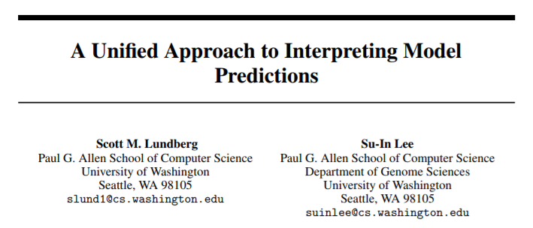
Interpretability State of the Art
Many methods and directions
Lately, united to some degree using Shapley values.
Lloyd Shapley : 1923 – 2016 , American
Nobel Prize in Economics 2012
One of the fathers of game theory

Slide 70
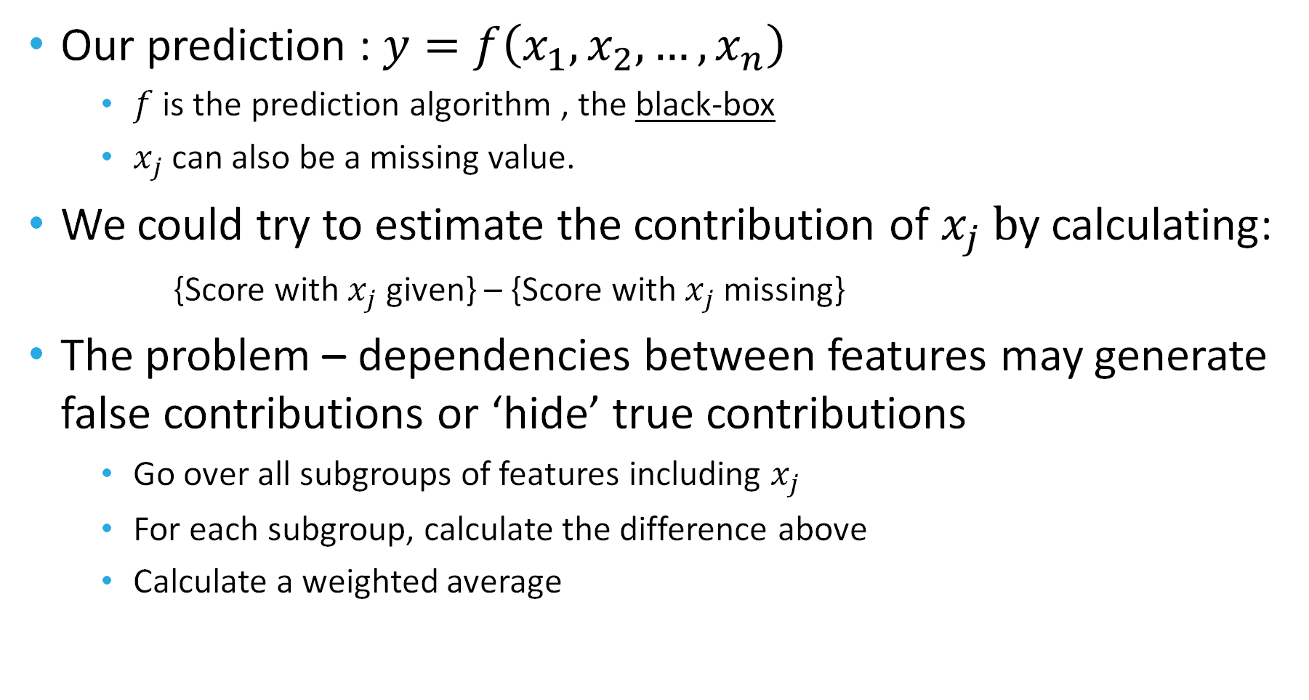
Introduction to Shapley Values

Slide 71
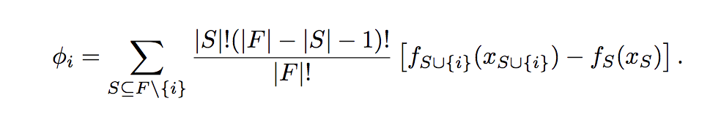
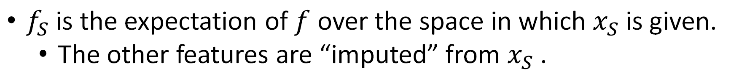
Introduction to Shapley Values
Shapley theorem gives the coherent method for calculating these averages (Shapley Values)

Slide 72

Challenges with Shapley Values
The number of subgroups is exponential
No straight-forward way to compute it on large feature sets
For some specific models, it is possible:
Linear models
Tree models
Including: random forest, xgb, lightgbm.
For other cases: we can try to estimate the value by sampling only a small part of the subgroups
We need a fast way to calculate the score given only a subgroup of the features.

Slide 73
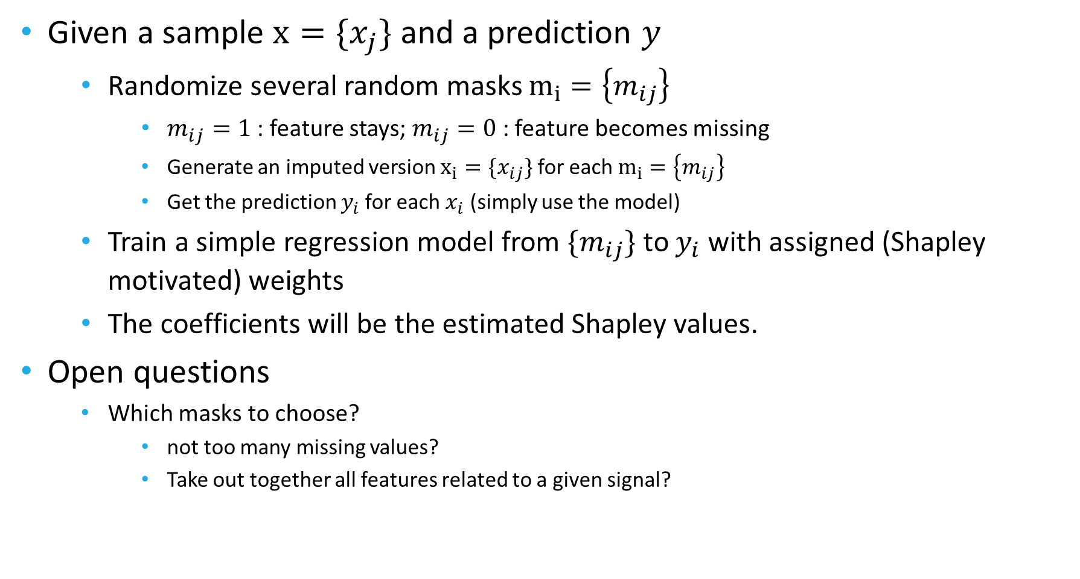
Shapley – LIME : agnostic to model

Slide 74
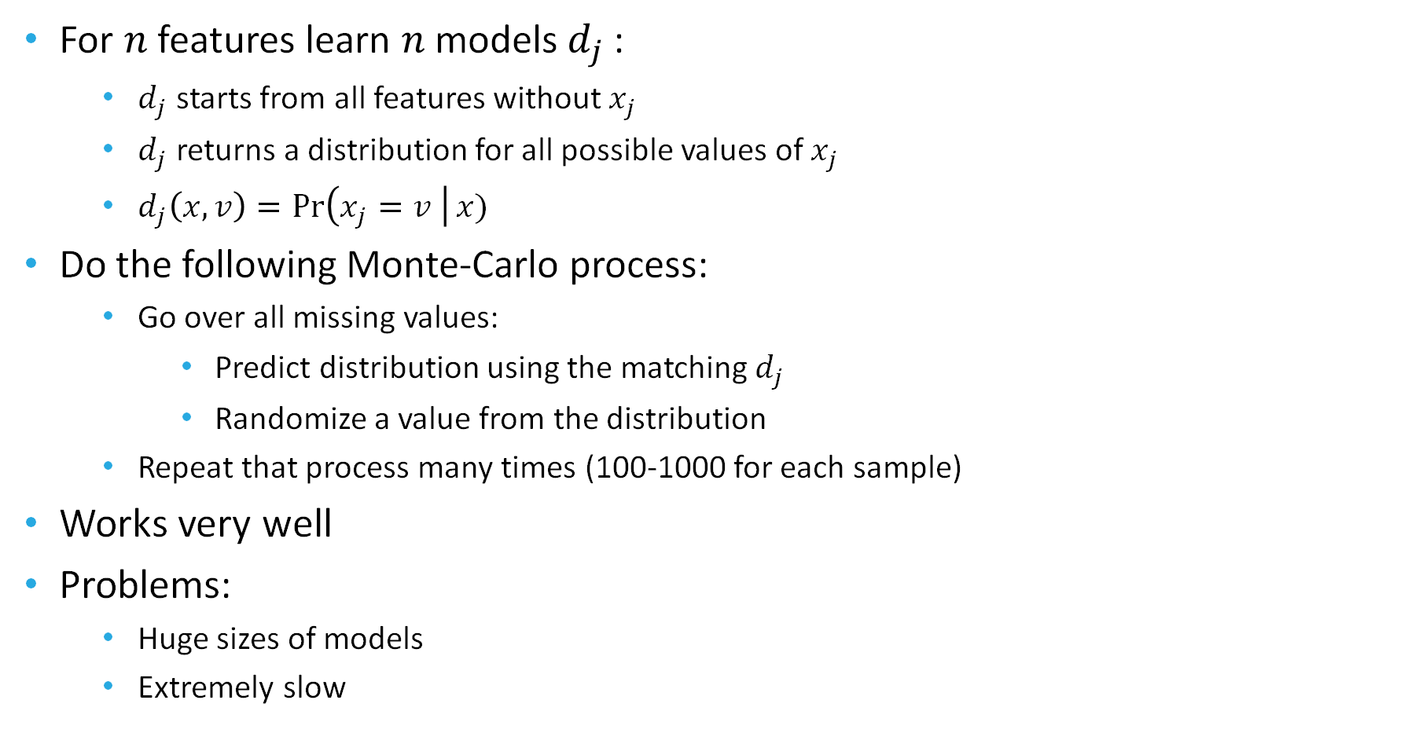
Imputation – Gibbs Sampling

Slide 75
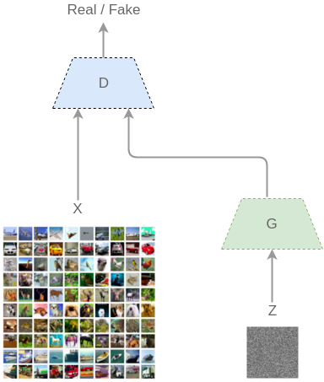
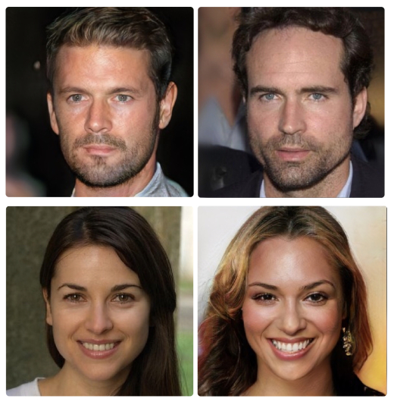
Imputation - GANs
A recent method using deep learning :
Z : Random numbers
G : Generator model
D : Discriminator model
Generator learns to fake samples that can’t be separated from real ones
Discriminator learns to separate real and fake samples

Slide 76
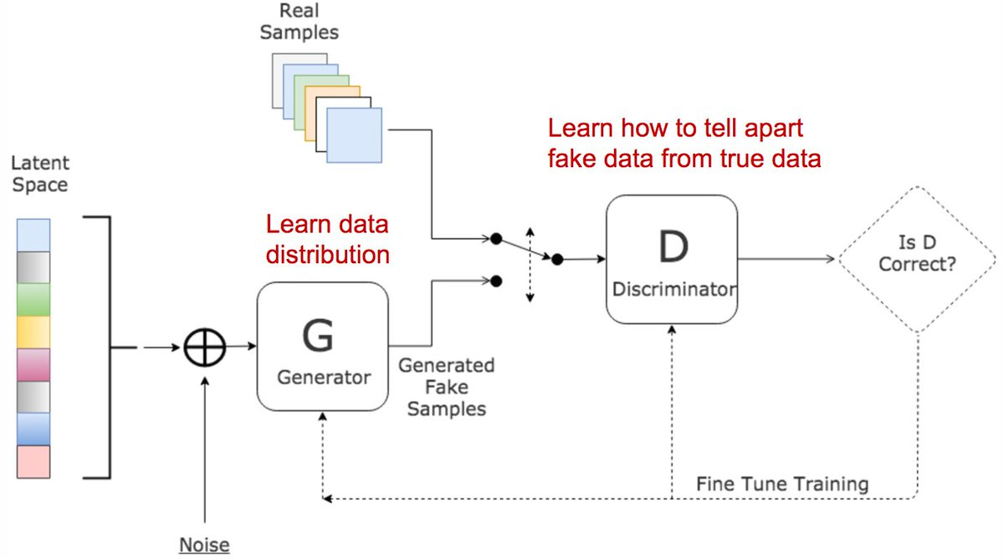
Imputation - GANs
Real Samples
Full samples
Samples with missing data
Fake Samples
Known features plus mask of missing
Generator fills in missing data
If needed sample is then masked with a random real data missing mask
Big Advantage : Compact model, and fast in usage (!)

Slide 77
Summary of Methodology
Model construction: Modular, C++ libraries, python APIs
Data Preparation
Model Generation
Data Model: Unified, efficient in time and memory
Validation & Analysis
Exporting
Datasets
Importing, Organization, Normalization, Ontologies
Cohort Preparation
Selecting population, Sampling, Labeling
Repository Processors
Outliers, Enrichment
Feature Generators
Moments, Trends, Embedding, Encoders
Feature Processors
Imputation, Feature Selection
Predictors
Regression, Trees, Boosting, Neural-Nets
Post-Process
Recalibration, Interpretation
Validation
Performance analysis, Bootstrapping, multiple datasets
AlgoAnalyzer
Export as AlgoMarker
Notes:
Option 1

Slide 78
Performance Analysis
Analyzing models performance can be a complex task
Choose the interesting performance measures
For classification – AUC, ROC curve
For specific working point – Sensitivity, Specificity, PPV, PR, OR, etc.
For regression – Correlation, Explained Variability, etc.
Performance may depend on the time gap between prediction and event
Performance is evaluated for different time-window before event
Make sure score is not associate with diagnosis process
A sample may be excluded or even change its label when using different time-windows
Evaluation of confidence interval and statistical difference between results is achieved by bootstrapping

Slide 79
Performance Analysis
Test-set incidence sometimes does not represent the real world
Some of the parameters must be corrected
Use external incidence information, correct for age/gender distribution
Matching and Filtering of samples before analysis
Check for added value over known factors
Check for spurious patterns
Check performance on population with different characteristics
Simulations used for estimating performance for user-specific, real-world applications
Evaluate clinical and financial benefit
Kaplan-Meier estimator for survival analysis

Slide 80
Performance Analysis - Report
Performance of the model for early detection of lung cancer
Smoking | Ages | Cancer | Stage | Time Window | AUC_Obs | SENS@FPR_2.5% | SENS@FPR_5% | SENS@FPR_10%
Ex_or_Current_Smoker | 55.000-74.000 | NSCLC | 0_I_II | 0.000-90.000 | 0.895 [0.883,0.905] | 41.4 [39.3,46.4] | 54.4 [51.3,58.6] | 69.6 [66.0,72.4]
Ex_or_Current_Smoker | 55.000-74.000 | NSCLC | 0_I_II | 90.000-180.000 | 0.868 [0.849,0.887] | 37.1 [32.5,42.9] | 52.3 [47.3,57.5] | 64.7 [59.8,69.4]
Ex_or_Current_Smoker | 55.000-74.000 | NSCLC | 0_I_II | 180.000-270.000 | 0.863 [0.843,0.884] | 30.8 [25.9,37.0] | 45.1 [40.4,51.8] | 63.3 [58.6,69.2]
Ex_or_Current_Smoker | 55.000-74.000 | NSCLC | III_IV | 0.000-90.000 | 0.898 [0.891,0.907] | 45.1 [43.2,48.6] | 57.1 [55.1,60.7] | 71.1 [69.0,73.9]
Ex_or_Current_Smoker | 55.000-74.000 | NSCLC | III_IV | 90.000-180.000 | 0.856 [0.840,0.870] | 34.1 [29.7,36.9] | 45.9 [41.5,49.8] | 59.6 [55.3,63.0]
Ex_or_Current_Smoker | 55.000-74.000 | NSCLC | III_IV | 180.000-270.000 | 0.852 [0.837,0.869] | 29.9 [25.3,33.2] | 42.2 [37.6,46.2] | 56.3 [52.3,61.1]
Ex_or_Current_Smoker | 55.000-74.000 | Adenocarcinoma | 0_I_II | 0.000-90.000 | 0.870 [0.856,0.887] | 38.3 [32.6,41.5] | 50.8 [44.4,53.8] | 62.8 [58.9,67.8]
Ex_or_Current_Smoker | 55.000-74.000 | Adenocarcinoma | 0_I_II | 90.000-180.000 | 0.837 [0.806,0.864] | 28.3 [22.8,34.1] | 45.1 [36.8,50.2] | 57.5 [49.8,62.8]
Ex_or_Current_Smoker | 55.000-74.000 | Adenocarcinoma | 0_I_II | 90.000-365.000 | 0.825 [0.806,0.848] | 28.3 [23.4,32.6] | 40.5 [36.2,45.2] | 52.2 [48.7,58.3]
Ex_or_Current_Smoker | 55.000-74.000 | Adenocarcinoma | III_IV | 0.000-90.000 | 0.872 [0.860,0.886] | 37.8 [34.1,41.2] | 49.6 [46.1,53.6] | 64.6 [60.9,68.2]
Ex_or_Current_Smoker | 55.000-74.000 | Adenocarcinoma | III_IV | 90.000-180.000 | 0.832 [0.811,0.855] | 29.1 [23.0,32.9] | 39.1 [34.1,44.6] | 53.3 [47.8,58.7]
Ex_or_Current_Smoker | 55.000-74.000 | Adenocarcinoma | III_IV | 180.000-270.000 | 0.831 [0.810,0.853] | 25.3 [20.3,30.1] | 36.5 [31.2,42.3] | 50.0 [44.0,56.3]
Ex_or_Current_Smoker | 55.000-74.000 | Squamous | 0_I_II | 0.000-90.000 | 0.923 [0.907,0.941] | 52.8 [46.1,59.6] | 65.1 [58.6,71.0] | 78.2 [73.2,84.6]
Ex_or_Current_Smoker | 55.000-74.000 | Squamous | 0_I_II | 90.000-180.000 | 0.913 [0.882,0.938] | 50.9 [40.7,61.7] | 66.7 [55.2,74.4] | 78.1 [69.2,85.2]
Ex_or_Current_Smoker | 55.000-74.000 | Squamous | 0_I_II | 180.000-270.000 | 0.900 [0.869,0.927] | 36.5 [26.9,45.7] | 53.8 [44.4,62.6] | 72.1 [64.2,81.2]

Slide 81
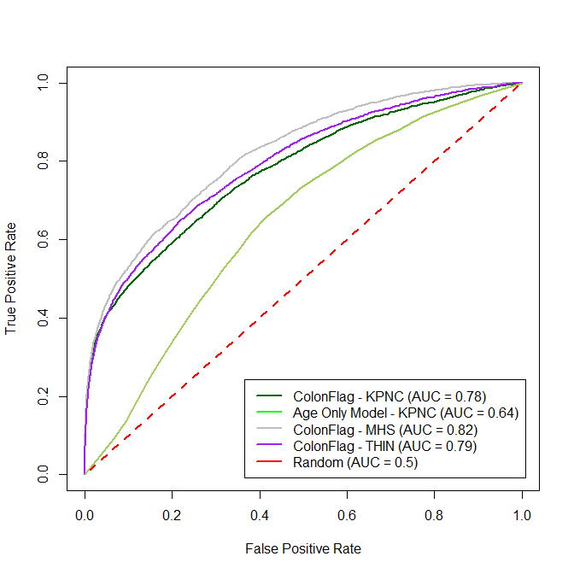
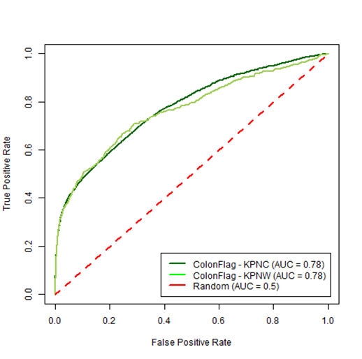
Validation – Internal and External
Check model performance on multiple internal datasets when applicable
Apply model on external datasets for additional validation
Blind validation, with labeling known only to third party, when possible
Check different population – ethnic characteristics, health-care environment, socio-economic parameters
Perform validation in a clinical trial setting
Publications

Slide 82
Performance Analysis – Model Selection
Perform grid or random search to optimize predictors’ hyper-parameters
Use cross validation for performance evaluation
Choose the performance measure(s) of interest
Possibly use multiple datasets
Other parameters of the whole process can also be optimized by systemic or random search
Feature-set optimization done using feature selector
Other elements (types of cleaning, imputation, etc.) require semi-automatic (yet fully parallelized) optimization
Performance is not the only consideration
Rare signals with small contribution should not always be added

Slide 83
External Validation and Transfer Learning
Internal
External
+
Model
Scores
Client Data
Features
Model
Retrained
Model
Trained on internal Data
Biological
No “client specific” features
Trained on large datasets
Uses the power of the Internal model
Incorporates client specific data to improve performance

Slide 84
Summary of Methodology
Model construction: Modular, C++ libraries, python APIs
Data Preparation
Model Generation
Data Model: Unified, efficient in time and memory
Validation & Analysis
Exporting
Datasets
Importing, Organization, Normalization, Ontologies
Cohort Preparation
Selecting population, Sampling, Labeling
Repository Processors
Outliers, Enrichment
Feature Generators
Moments, Trends, Embedding, Encoders
Feature Processors
Imputation, Feature Selection
Predictors
Regression, Trees, Boosting, Neural-Nets
Post-Process
Recalibration, Interpretation
Validation
Performance analysis, Bootstrapping, multiple datasets
AlgoAnalyzer
Export as AlgoMarker
Notes:
Option 1

Slide 85
Serialization – An Enabler For Productization
A ‘Model’ include all stages of the process from MedRepository signals to post-processed predictions
It is extremely important to be able to save all the complex paths a model goes through in order to get a prediction.
Thus, we need to keep –
List of required signals lists
Repository Processors, Feature Generators, Feature Processors withal their parameters
Predictor and Post Processors used with all their parameters.
For ease of use, our serialization keeps all of this into one single file
The file can be used for further training or for internal testing
The same file is used as the engine for the final product (AlgoMarker)
Serialization process is complex as it allows for backward compatibility even when objects are changed, and parameters added.

Slide 86
AlgoMarkers and the AlgoAnalyzer
AlgoAnalyzer is the product environment to use our models -
A wrapper library allows the usage of models in field with the AlgoAnalyzer.
The engine (AlgoMarker) is the serialized model file
APIs include –
Load an AlgoMarker
Push data into a virtual in-memory repository (removing after usage)
Apply model on data and report scores (raw or calibrated), eligibility information, error information, and But-Why information.
Heavily tested, stabilized, efficient
Uses the exact same model created in the training (the same serialized file).

Slide 87
Summary of Methodology
Model construction: Modular, C++ libraries, python APIs
Data Preparation
Model Generation
Data Model: Unified, efficient in time and memory
Validation & Analysis
Exporting
Datasets
Importing, Organization, Normalization, Ontologies
Cohort Preparation
Selecting population, Sampling, Labeling
Repository Processors
Outliers, Enrichment
Feature Generators
Moments, Trends, Embedding, Encoders
Feature Processors
Imputation, Feature Selection
Predictors
Regression, Trees, Boosting, Neural-Nets
Post-Process
Recalibration, Interpretation
Validation
Performance analysis, Bootstrapping, multiple datasets
AlgoAnalyzer
Export as AlgoMarker
Notes:
Option 1

Slide 88
Model Construction – the Complete Picture
A unified language to define and work with ML projects.
Raw Data
Semi Automated
Repository
Optional
Modeling
& Testing
Export as AlgoMarker
Cohort
Train/Test Lists
Configure:
Cleaning
Features
Selection
Normalization
Model
Sampling
Filtering
Matching
Splitting

Slide 89
Model Construction – the Code
All processes use internal (or imported) C++ libraries
Highly efficient in memory usage
Fast
Highly parallelized to improve performance on a single machine
Large, debugged and documented body of code
A large set of tools (C++ executables) wrap the basic capabilities to allow -
Loading to repositories
Model training, testing and export
Parameters optimization
Feature matrix export
Cross validation
Generation of cohorts and sample sets
Printing out models’ information
Graphical viewers for patients
More…
All of the basic capabilities and most of the tools are wrapped and have Python APIs
Exploratory projects using Jupyter notebooks
Use Python’s graphical tools
Combine with TensorFlow

Slide 90
Model Construction – the Data Repository
MedSignal
Configuration File
Command Line Params
MedDictionary
MedRepository
InfraMed: Data Repository Infrastructure
Data Handling Tools
Pid-Repository
Loading Signals
Accessing Signals
Changing Signals
Accessing Dictionaries
Loading Data
Viewing
Handling Units
Fixing Resolutions
Dynamic Pid-Repository

Slide 91
Model construction – Cohort and Samples
Command Line Params
Problem Specific Code
MedCohort
Cohort Generation Tools
MedRepository
MedSamples
Sampling Tools
Command Line Params

Slide 92
Model construction – Training and Testing
Rep Processors
MedRepository
MedSamples
Json Configuration
Feature Generators
MedModel
MedProcessTools: Model Construction Infrastucture
Learning/Testing tools
Feature Processors
MedFeatures
Learning Models
Applying Models
Calibrating Models
Learn/Test
Cross Validation
Optimization
View Model Details
MedPredictors
Post Processors

Slide 93
Model construction – Performance Analysis
Configuration file
Bootstrapping: Infrastructure for Performance Analysis
Performance Analysis Tool

Slide 94
Internal or External Sandboxes
Internal
External
Data Center
20M+ records
100M+ patient years
Data Server
Client Data
Computing Cluster
Computing Server
Installed with Medial Tools
Repository/Training/Testing/Exporting
Secured
Secured Access

Slide 95
Model construction – the Usage
Everything is highly configurable
To train a new model, no need to write code
A simple Json format configuration file defines all the stages selected for the model and their parameters
Unifying the whole process of ML on medical records to one paradigm.
Additional command-line parameters for many of the tools
Hands on example will follow …
Effortless porting to AlgoAnalyzer
A new “language” for Medical ML was created.

Slide 96
What are We Working on Now ?
Enrichment and improvement of Infrastructure
Building new AlgoMarkers
Research Directions –
But Why ?
Causal Inference
Multiple Imputations
Continuous Signals
Additional blood counts parameters
Treatment/Tests Rationalization (anemia)
RNNs
Blue Sky Research

Slide 97
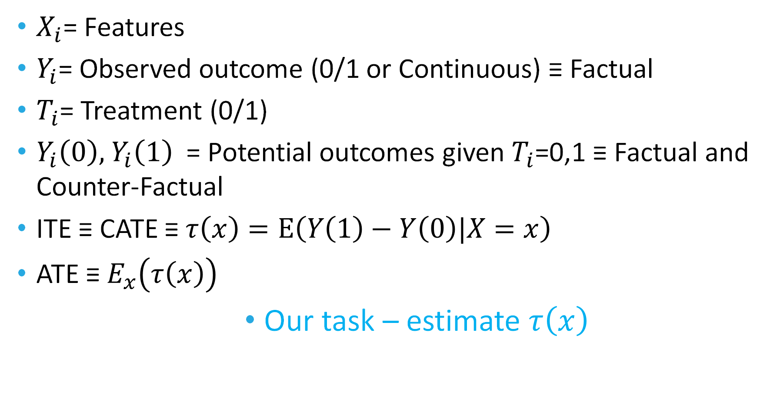
Research Challenges – Causal Inference (What If ?)

Slide 98
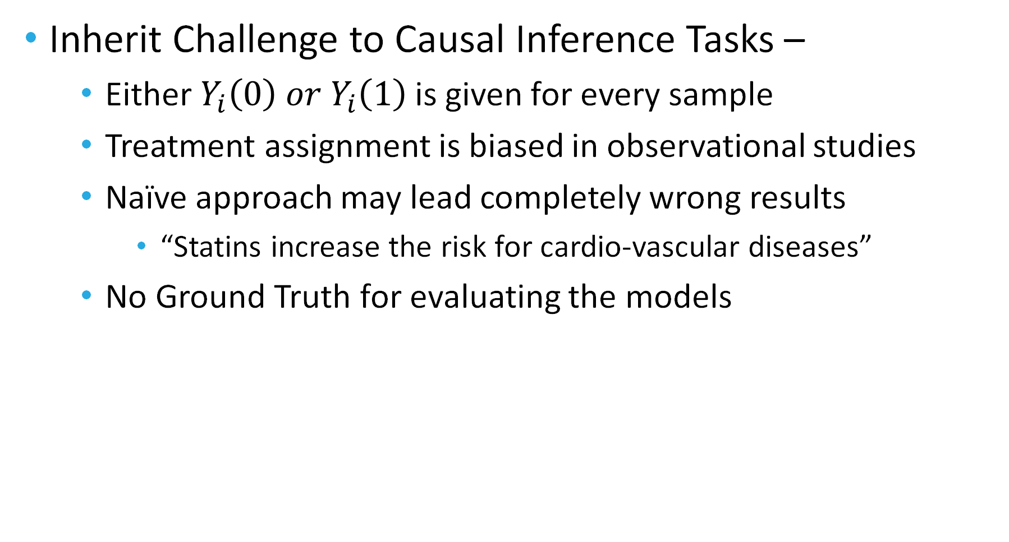
Research Challenges – Causal Inference (What If ?)

Slide 99
Research Challenges – Causal Inference (What If ?)
Methods for facing the Causal Inference challenge
Inverse Propensity Weighting
Propensity Stratification
G-Computations – X and R-learners
Quasi-Oracle
Counter-Factual Regression
And more ideas published every day

Slide 100
Time for some hands-on examples …

